Slide 1
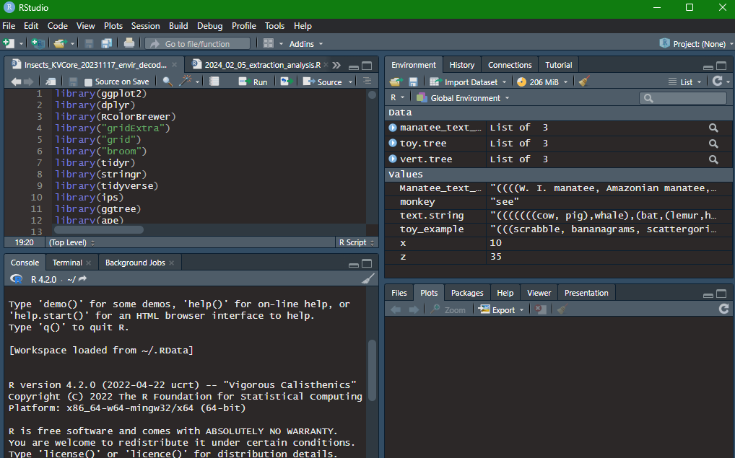
Rstudio Interface
Left: Script + Console/ Terminal/Background Jobs
Top-right area: Environment + History, Connections, Tutorial
Bottom-right area: Files, Plots, Packages, Help, Viewer and Presentation
https://www.datacamp.com/tutorial/r-studio-tutorial
Notes:
Fsfddf

Slide 2
Rstudio Interface
Create a folder in your computer where you want this workshop to go!
Write a new script in Rstudio: File > New File > Rscript. Type Ctrl+S (or File > Save) and save it to this folder.
In the script, write out setwd(“C:/path/to/the/file”) and click Ctrl+Enter.
Now on to the lesson!

Slide 3

Beginner’s guide to ggplot2
Kirsten Isabel Verster
BIOS 252 Mini Course
Notes:
About me and who I am
Kirsten, an upcoming postdoc at Stanford U. I study horizontal gene transfer in insects and I’m about to graduate in a few months. I will be working in the lab with Dr Liz Hadly.
I mainly work in genomics, functional genomics. I honestly have been using R on and off and I don’t consider myself by any means an expert at it. But I do use it practically, for specific purposes, and I’ve seen how powerful it can be and how much more intuitive than the base R packages
My proudest image in R

Slide 4
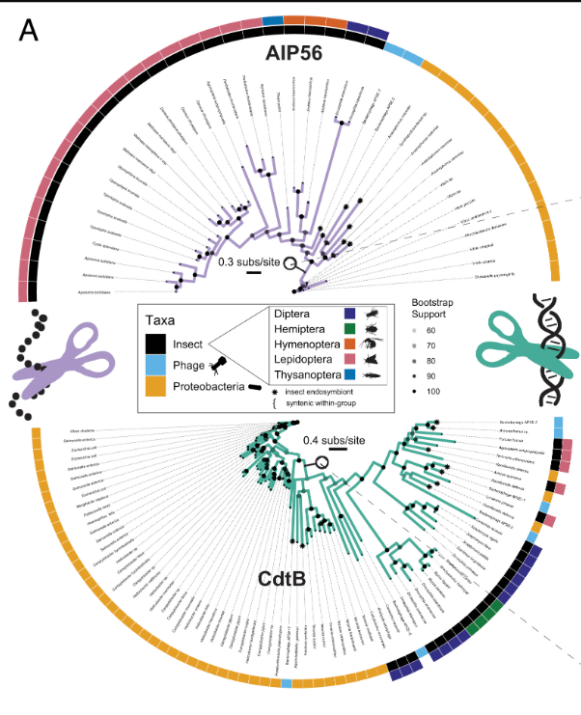

Slide 5
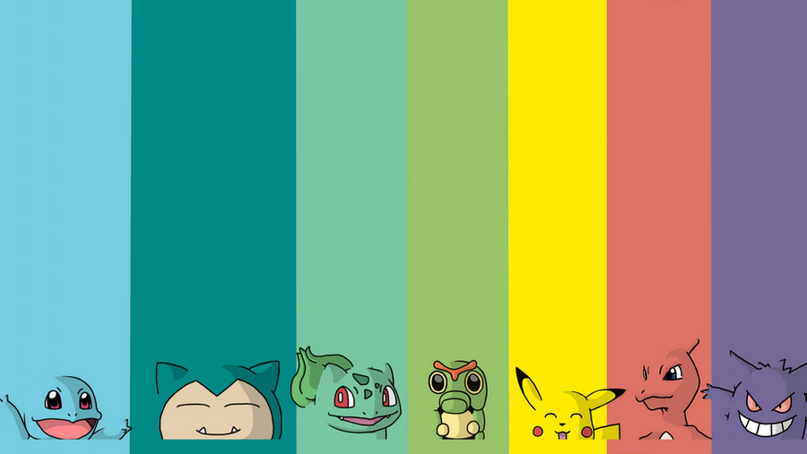
Itinerary
On the “grammar of graphics”
The syntax and elements of a ggplot2 object
Several practical examples using Pokémon dataset (follow along on https://github.com/kirver/ggplot2)
Notes:
My plan was to walk you through ggplot2.
Gg in ggplot is for “grammar of graphics”, which is a philosophy behind graphical representation which has several books written about it. I will be super brief re: this but it’s important to discuss in order to understand the history and the logic behind ggplot.
Then, I will describe the logic, the syntax behind building a ggplot2 graph.
And then I made a GitHub and we will follow along it together, with lots of practical examples, and ways of manipulating, a ggplot object
And then, we will follow along with a few key examples using a Pokemon dataset in a .csv file. I did this for a few reasons.
This is based off of a model I developed to teach R and Rstudio for a practical genomics class which was at the height of the pandemic and entirely online.
The main difference between this module and the stuff I usually see online is that it is built off a csv file, which isrealistically how many of u store ur data, while online many of the examples are built off of like a random number generator tu sa. I also really wanted to distract myself, and I like Pokemon , and this was a good way to think deeply about data while not using a lot of the kind of depressing stuff that was surrounding me – for example I saw a lot of stuff about covid rates and data manipulation for that and I was like hell naa
Who here knows what Pokemon are?

Slide 6
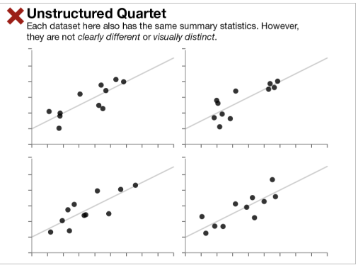
The importance of graphical representation
Notes:
At one point there was an argument about what was more important, summary statistics or looking at graphs. Some people thought summary stats like the mean, mode, etc; were the most important thing in visualizing data and being really “ scientific”, unbiased, etc;
Graphical representation is important because that way we can actually see the data points, or the distribution of the data, and identify important trends.
Sometimes the importance isn’t very clear: for example, these images all have the same mode, distribution, etc;. An dthey all look more or less the same. So u might not see a point in showing them. However, the picture becomes a little less clear when we see the next….

Slide 7
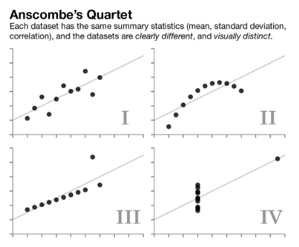
The importance of graphical representation
F.J. Anscombe in 1973: … four clearly different and visually distinct datasets are producing the same statistical properties.
“Numerical calculations are exact, but graphs are rough”.
Notes:
Graphs, which also have the same summary stats but clearly have very different patterns. This pattern of graphs is called Ascombe’s quartet, and it was a direct response to the “controversy” at the time people were having about like the philosophy of data

Slide 8
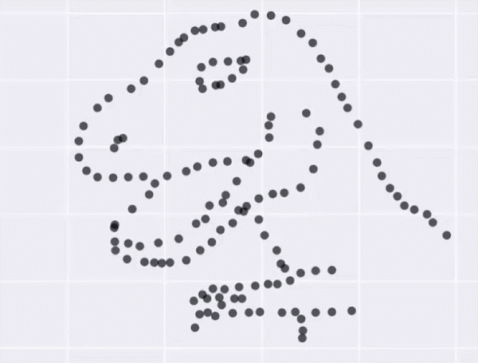
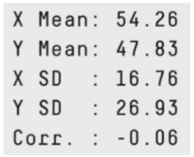
The Datasaurus Dozen
"never trust summary statistics alone;
always visualize your data”
tinyurl.com/gg2022sssg
Notes:
My next super favorite example is this one, called the Datasaurus dozen, which is the same idea as Ascombe’s quartet but like, funner
Matejka and Fitzmaurice made 200,000 incremental changes to the Datasaurus data set, slightly shifting points so that the summary statistics stayed within one-hundredth of the originals
So, this is why graphs are important. But how should you make graphs? How do you describe them?

Slide 9
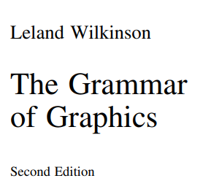
The Grammar of Graphics
Grammar is defined as a set of structural rules which helps define and establish the components of a language
A grammar of graphics is a framework that enables us to concisely describe the components of any graphics
A GOG follows a layered approach by using defined components to build a visualization
tinyurl.com/gg2022gog
Notes:
To that, we turn to the GoG, which was formalized in a text by [ clic ] Leland Wilkinson. It talks about how to build up on graphics.
It also has a few like, killer quotes [CLIC] lobster quote
The people at this time , back in 1999, were thinking about creating a philosophy of like, data and data interpretation and visualization, which they argue is a kind of language in and of itself. And, any language
[clic] requires a “grammar” to define and establish the language components
[clic] and, a grammar for data visualization, or graphics, would create a framework that enables us to describe simply the graphic components
[clic] the GOG follows a layered approach by specifically qualifying what the elements are

Slide 10
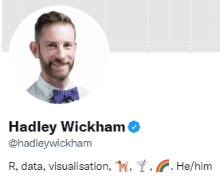
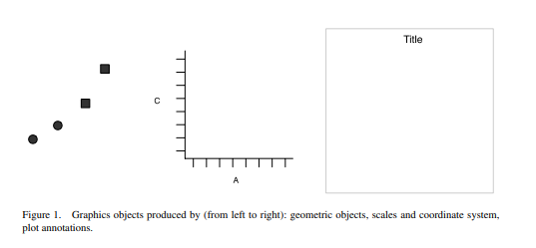
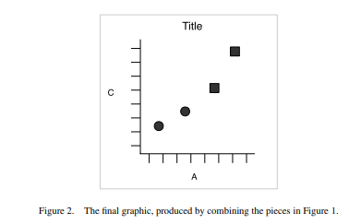
Layered grammar of graphics
Created by Hadley Wickham
https://tinyurl.com/gg2022layered1
Notes:
Hadley Wickham argued that the best grammar for visualizing graphics must be LAYERED. Where each element builds on top of each other for the final whole product. And it describes getting from the point of Data, point A, to the graphic, point B.
So in this image we have a graph,. A mathematical graph cannot be seen. It is an abstraction. A graphic, however, is a physical representation of a graph.
: the data, represented by something called geom; the scales and coordinate system, which generates axes and legends so we can read values from the graph; and the plot annotations, such as the background an dplot title.
[clic]
When we combine graphical objects from these sources, we have the final graphic.

Slide 11
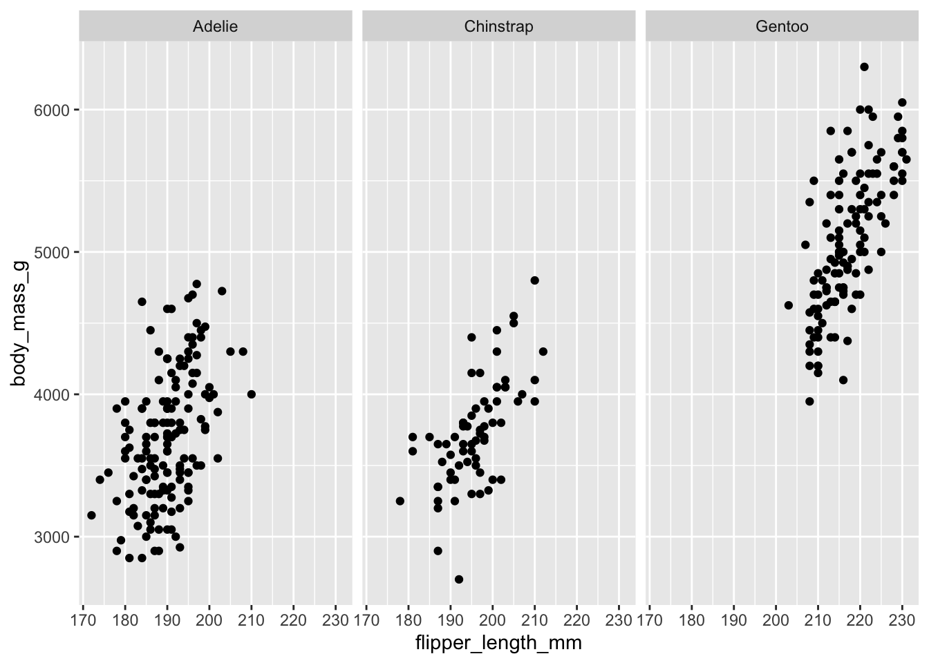
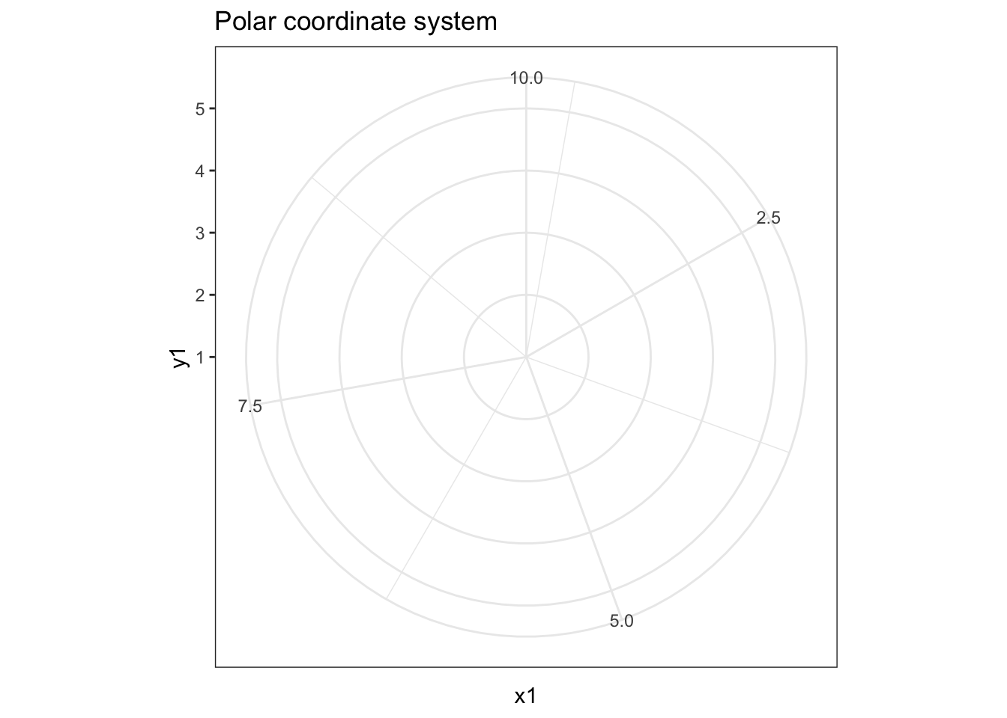
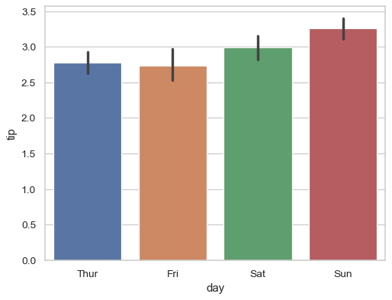
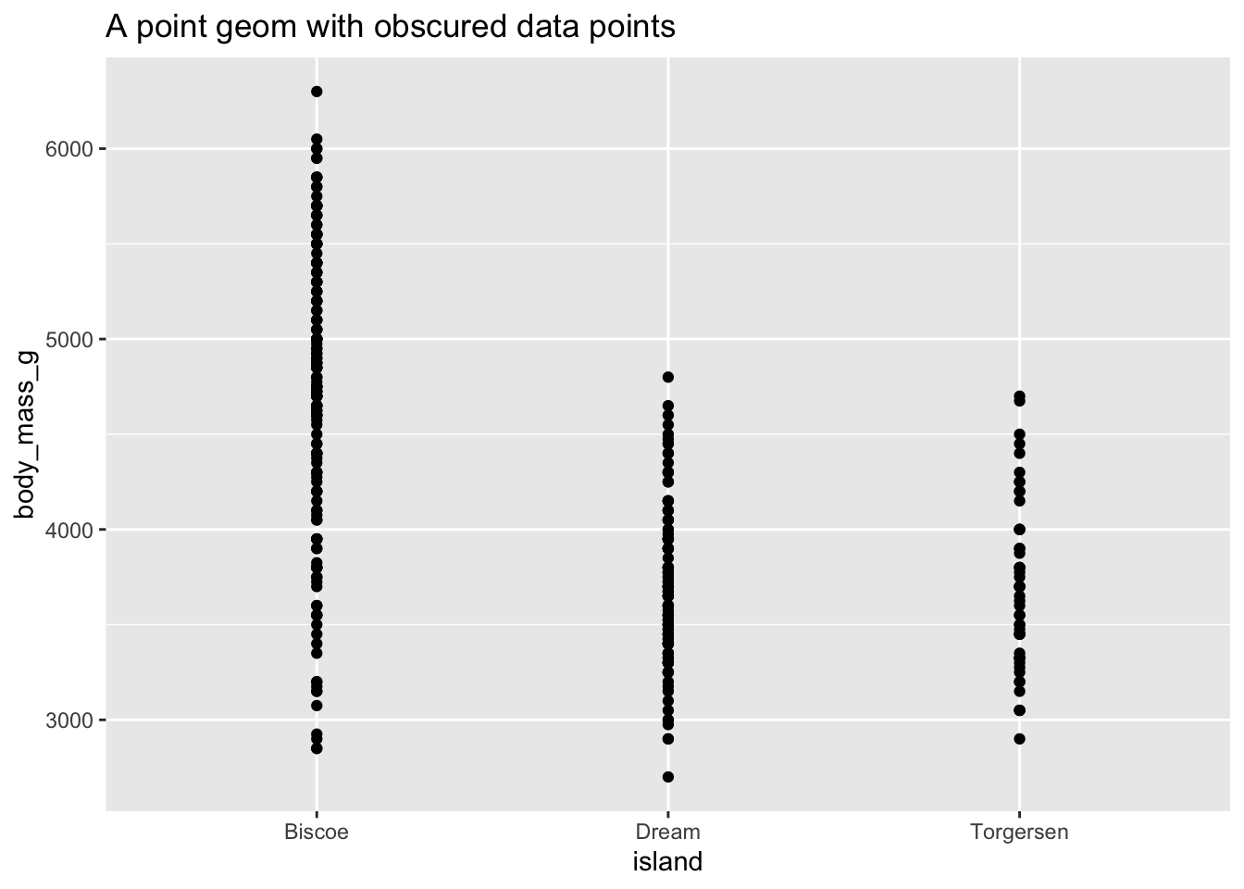
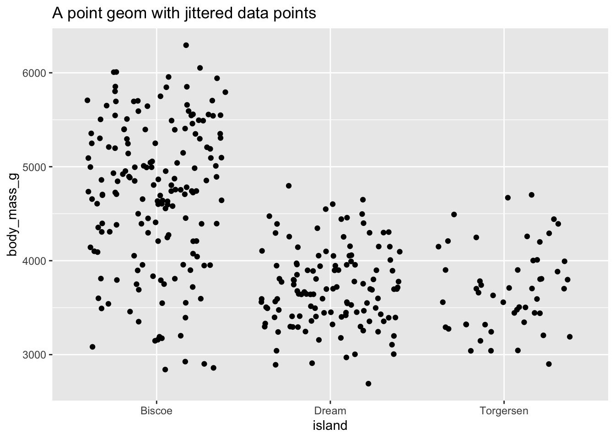
Components of the layered grammar
Layer
Data
Mapping
Statistical transformation (stat)
Geometric object (geom)
Position adjustment (position)
Scale
Coordinate system (coord)
Faceting (facet)
Defaults
Data
Mapping
https://tinyurl.com/gg2022uchic
Notes:
This slide is going to go a little more in depth into some of these components that make up the layered grammar, ways of manipulating elements of the graph to communicate ur message
Layers are related to each other and share many common features. For example, multiple layers can be built using same underlying data – like a [CLIC] scatterplot overlayed w a smoothed regression line . In this case, the scatterplot, the actual points are one layer while the regression line is another layer. However, they are derived from the same data, but convey slightly different information.
Data defines the source of information to be visualized, but is independent from other elements
Mapping defines how variables are applied to the plot. (what is in x position, what is in y position?) e.g. these data could have the X and Y switched up
Stat – transforms the data. CLIC E.g. a bar graph, you are not graphing the raw data, but rather the mean and the SE. takes in a dataset as input and returns a diff dataset as the output.
CLIC Geoms – control type of plot you create. Classified by their dimentionality – 0 dimensions, point, text; 1 dim, path, line, 2d, polygon, interval.
CLIC Position adjustment e.g. stack, dodge to avoid bars overlapping.
Scale - controls how data is mapped to aesthetic attributes; e.g. color scale; size scale
CLIC Coord- maps positions of objects onto the plane of th eplot, controls how the axes and grid lines are drawn. Usually 2 coordinates, but could be more. E.g. Cartesian (this one), or polar.
CLIC Faceting – can split the data up into subsets of the entire dataset. Allows subsets to be visualized on the sam eplot
Default – finding a simplified grammar to make all these manipulations and moficiations

Slide 12
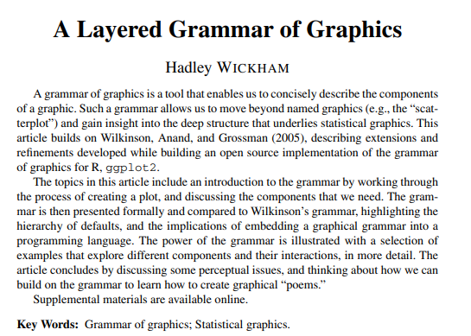
Ggplot2 is a package implementation of the Grammar of Graphics
ggplot2 is a powerful and a flexible R package, implemented by Hadley Wickham, for producing elegant graphics. The gg in ggplot2 means Grammar of Graphics.
tinyurl.com/gg2022layers

Slide 13
Pulling them all together
Running ggplot() creates a new plot object in the existing R language
Then you add layers, like an onion, specifying the data, mapping, geom & stat, position scales, and coordinate systems
Any aesthetics specified in the layer will override defaults
Notes:
Pg 15 from Wickham

Slide 14
Time to walk through some common graph types!
https://github.com/kirver/ggplot24

Slide 15
Some helpful links
https://rafalab.github.io/dsbook/ggplot2.html
https://towardsdatascience.com/a-comprehensive-guide-to-the-grammar-of-graphics-for-effective-visualization-of-multi-dimensional-1f92b4ed4149
http://r-statistics.co/Top50-Ggplot2-Visualizations-MasterList-R-Code.html

